Slide 1

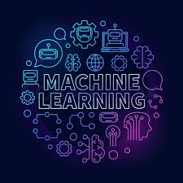
MAIML: Model-Agnostic Interpretable Machine Learning
2021-117

Slide 2


INTRODUCTION
What is ‘Interpretable Machine Learning’ & Why we need it?
Providing explanations for algorithmic decisions
to improve the reliability of algorithmic decisions
Can we trust a Decision made by a machine without Explanation?
Why certain decisions/ predictions have been made ?
2021-117

Slide 3
BACKGROUND
There are two types of models can be identified in Explainability
White-box
Black-box
Black Box models perform well and produce better accuracies,
Ex: SVM, Deep Neural Networks, XGBoost, KNN etc
Black-box models are high complex and the internal logic cannot understand by the users
Concept of Explainable AI has been come into the picture to overcome that situation
2021-117

Slide 4
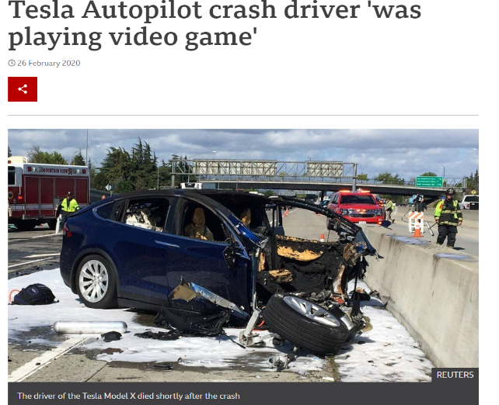
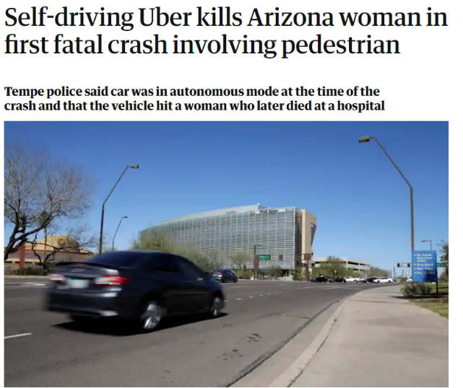
BACKGROUND
Why it is that much important?
Transportation
Health
Legal
Finance
Military
According to the laws of many countries, machine generated decisions
should be able to provide justifications
Ex: European Union's GDPR
The concept allows end users to identify the correctness of the results and the biasness
bbc.com/news/technology-51645566
2021-117

Slide 5
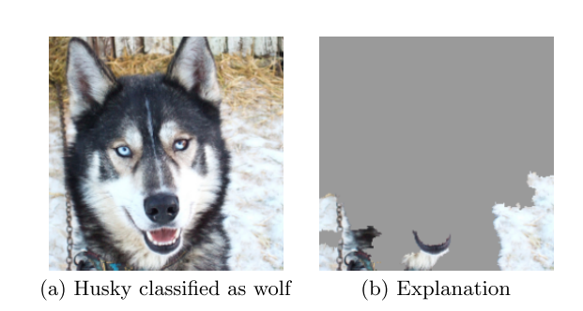
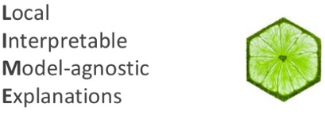
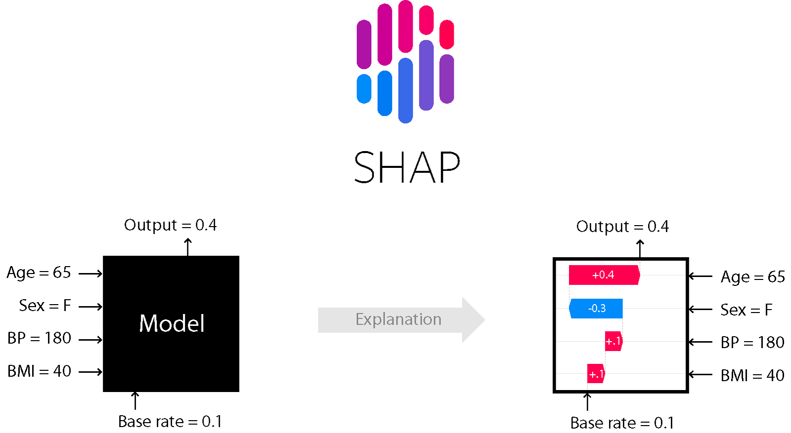
BACKGROUND
Proposed methods,
LIME[29], SHAP [14], Local rule-based explanations[19], etc
A popular scenario given by LIME,
A Husky has been classified as a wolf
Model considered only the snow background
Classifier has misclassified the image
LIME SHAP
2021-117

Slide 6


RESEARCH PROBLEM
Internal logic of the Black-Box Models cannot be understood by the users
Existing methods are difficult to understand by the general users
2021-117

Slide 7
Objectives
Specific Objective
Sub Objectives
Implement a framework to enhance the interpretability of the black box models and provide more user-friendly explanations than existing methods
Developing a model agnostic library to detect fairness in Machine learning models
Provide unified explanations to the predictions provided by CNN using currently available methods.
Enhance the model interpretability of SVM model and provide counterfactual explanations
Enhance the model interpretability of k-NN model overcoming ‘Curse of Dimensionality’ problem
2021-117

Slide 8
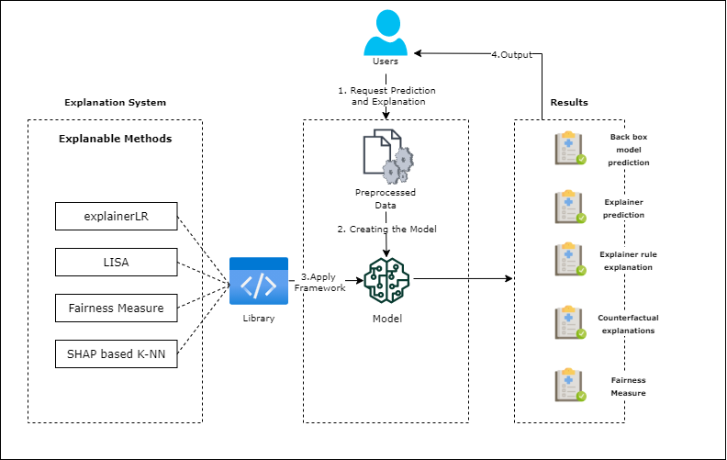
SYSTEM DIAGRAM FOR OVERALL SYSTEM
2021-117

Slide 9


COMMERCIALIZATION
Modern Trend of AI in different domains
Task Automation
GDPR is not giving access
Problem of Reliability, Transparency
May get a huge demand
Provide a library for the clients in
subscription basis or one time purchasing
2021-117

Slide 10
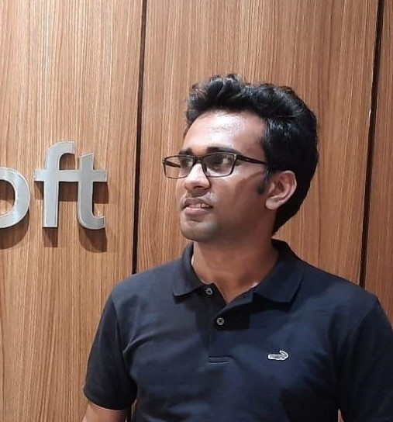
IT 18113600 | Perera g.y.n
Data Science
IT18113600 | Perera G.Y.N | 2021-117

Slide 11
Introduction
IT18113600 | Perera G.Y.N | 2021-117

Slide 12
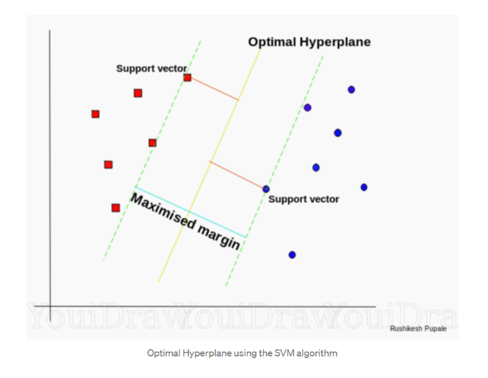
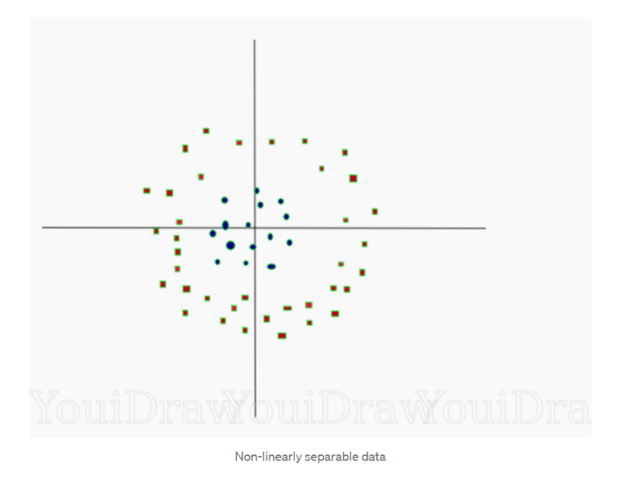
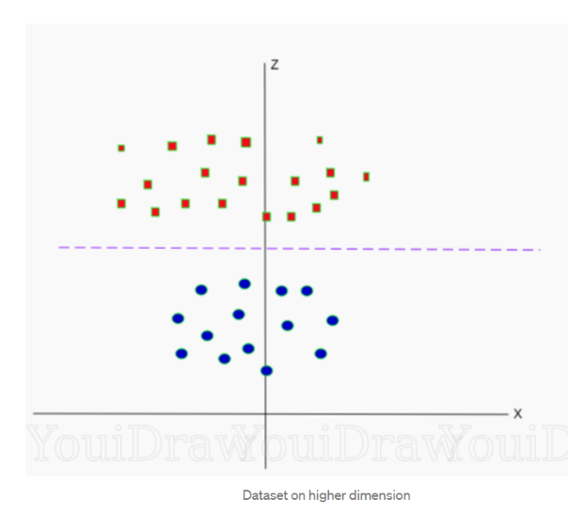
BACKGROUND
What is Support Vector Machine(SVM)?
Support vector machine is a supervised learning model which works well in practical situations and provides better accuracies.
The model is mainly used for binary classification tasks
SVM performs well with both linear and non-linear data using “Kernels”.
Real World usages of SVM: Bioinformatics, Face detections, Text classifications etc.
Linear data
Non-linear data
Images: https://towardsdatascience.com/https-medium-com-pupalerushikesh-svm-f4b42800e989
IT18113600 | Perera G.Y.N | 2021-117

Slide 13

BACKGROUND cont..
How is the interpretability of the model?
Unfortunately, it is a Black-box model[6].
Do we need to care about it?
Model should have better interpretability, if the usage is very critical
It must explain the relationship between inputs and outputs
IT18113600 | Perera G.Y.N | 2021-117

Slide 14
BACKGROUND cont..
What are the Counterfactual Explanations?
To flip the prediction, what are the changes that need be done to the model features.
Ex:
“you would have received the loan
if your income was higher by $10, 000”
Feature: income
Counterfactual explanation: if income > $10,000,
applicable for the loan
Diverse Counterfactual Explanations (DiCE)[7] is a popular
counterfactual framework
IT18113600 | Perera G.Y.N | 2021-117

Slide 15

RESEARCH QUESTION
Existing methods mainly focusing on binary predictions
The approach has not been properly applied with multivalued classifications
Counterfactual rule generations also have been done for binary predictions only
Final outcomes are not properly visualized
IT18113600 | Perera G.Y.N | 2021-117

Slide 16
OBJECTIVES
Specific Objective
Enhance the model interpretability of black box models and provide counterfactual explanations
Sub Objectives
Prepare the datasets
Generate neighbourhood with training data
Extract the explanation rule from decision tree classifier
Extract counterfactual explanations from decision tree classifier
IT18113600 | Perera G.Y.N | 2021-117

Slide 17

Research Methodology
IT18113600 | Perera G.Y.N | 2021-117

Slide 18
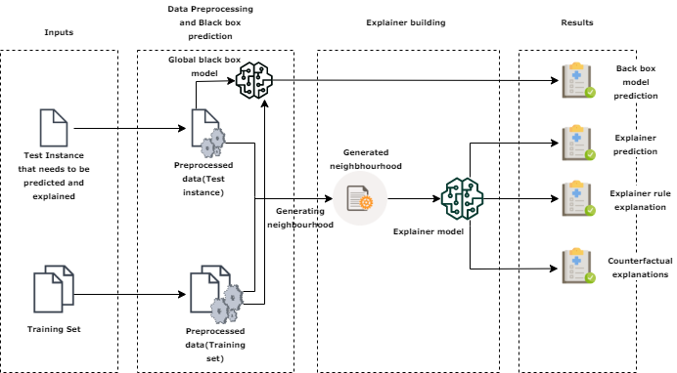
SYSTEM OVERVIEW DIAGRAM
IT18113600 | Perera G.Y.N | 2021-117
IT18113600 | Perera G.Y.N | 2021-117

Slide 19
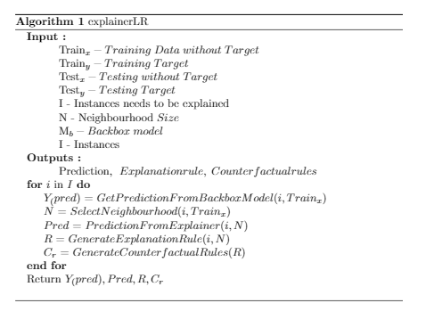
ALGORITHM
IT18113600 | Perera G.Y.N | 2021-117
IT18113600 | Perera G.Y.N | 2021-117

Slide 20
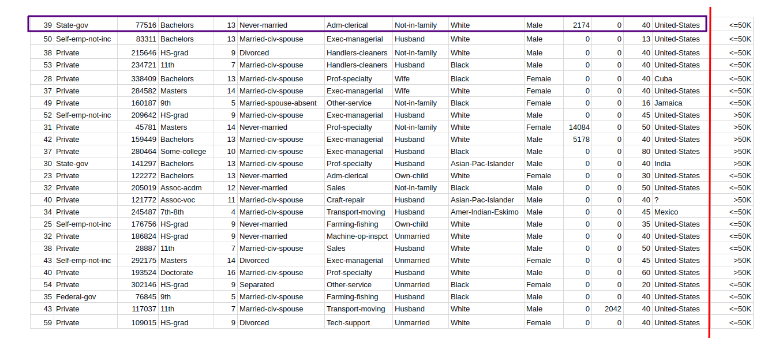
METHODOLOGY cont.…
Training Dataset
Generated Neighbourhood
New data record for prediction
IT18113600 | Perera G.Y.N | 2021-117

Slide 21

METHODOLOGY cont.…
Generated Neighbourhood
Identify the rules from decision tree
Identify the counter factual explanations/rules
IT18113600 | Perera G.Y.N | 2021-117

Slide 22
TECHNOLOGIES, TECHNIQUES AND ALGORITHMS
Technologies
Development: Python
Techniques
Distance functions for neighbourhood generations
Algorithms
SVM
VCS: Gitlab
Encoding and Decoding
Decision tree classifier
IT18113600 | Perera G.Y.N | 2021-117

Slide 23


Completion
STEP 1
STEP 2
STEP 3
STEP 4
STEP 5
STEP 6
Gathering
Sample data
and build the model for prediction
Distance calculation for specific instance & Neighbourhood generation approach selection
Decision tree classifier implementation
Giving the
model prediction along with explanations
Counterfactual Rule extractions for the given instance
Finalizing the library structure with best practices, report generation & Final testing for complete library
IT18113600 | Perera G.Y.N | 2021-117

Slide 24
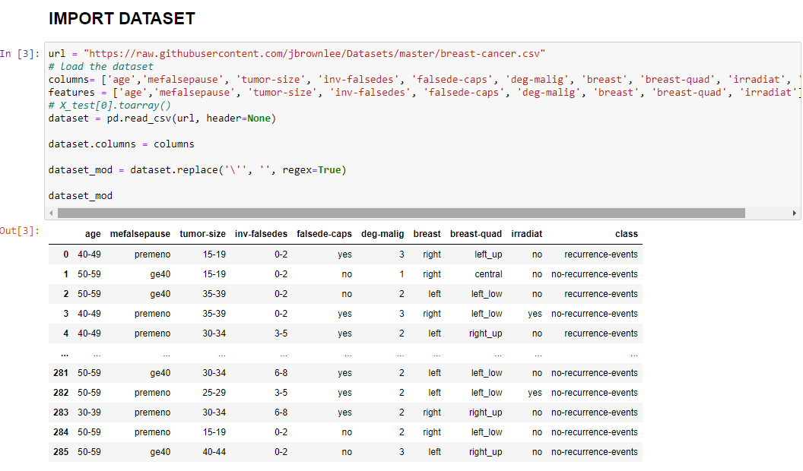
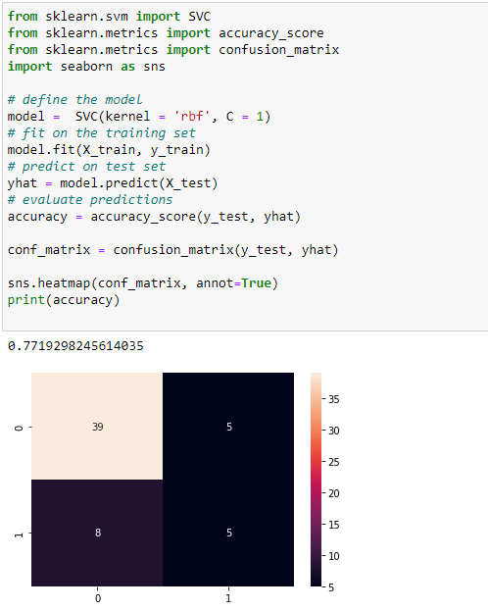
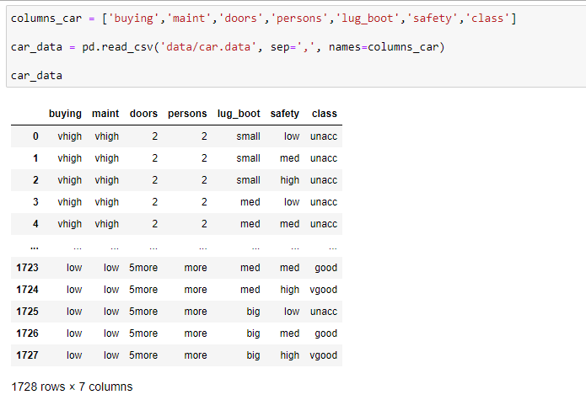
GATHERING SAMPLE DATA AND BUILD THE MODEL FOR PREDICTION
IT18113600 | Perera G.Y.N | 2021-117

Slide 25
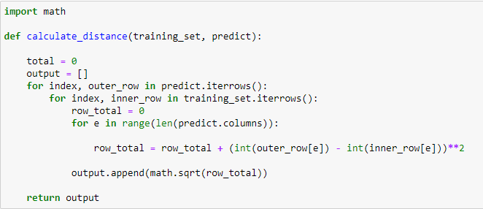
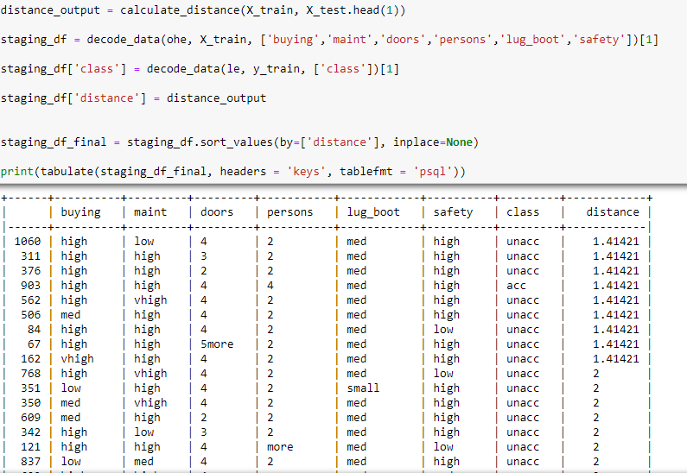
DISTANCE CALCULATION FOR SPECIFIC INSTANCE AND NEIGHBOURHOOD GENERATION APPROACH SELECTION
IT18113600 | Perera G.Y.N | 2021-117

Slide 26
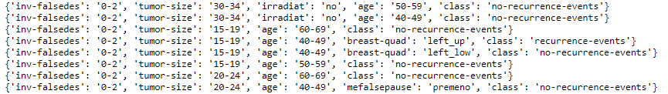
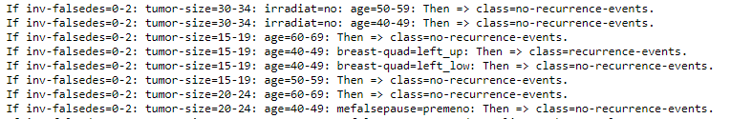
DECISION TREE CLASSIFIER IMPLEMENTAION
C4.5 Implementation – selected method
YaDT: Yet another decision tree Builder (Based on C4.5)
IT18113600 | Perera G.Y.N | 2021-117

Slide 27
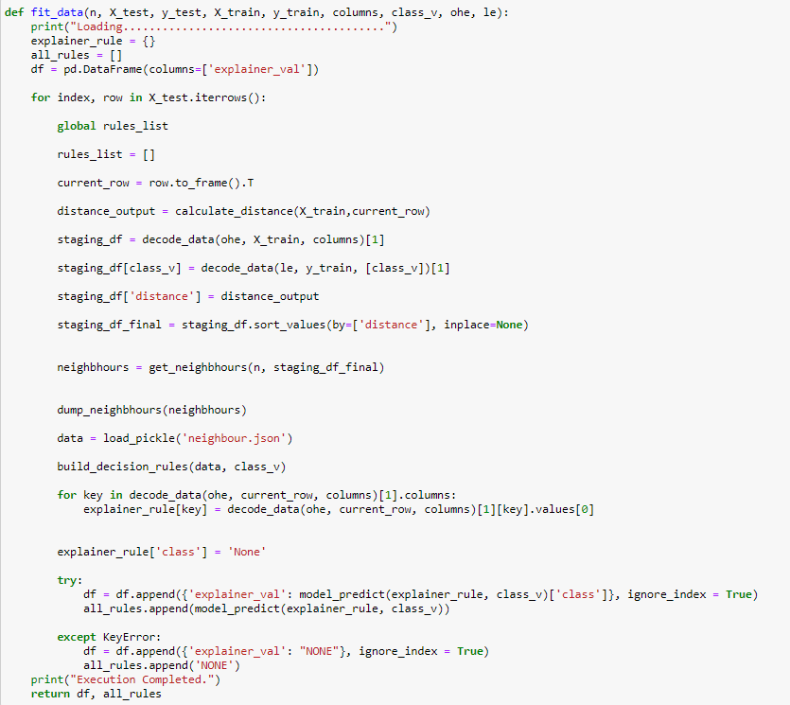
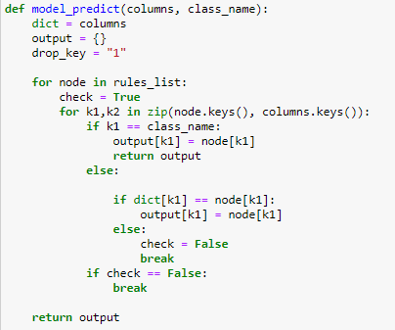
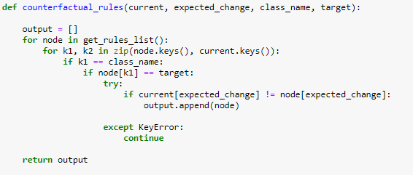
EXPLAINER IMPLEMENTAION
IT18113600 | Perera G.Y.N | 2021-117

Slide 28
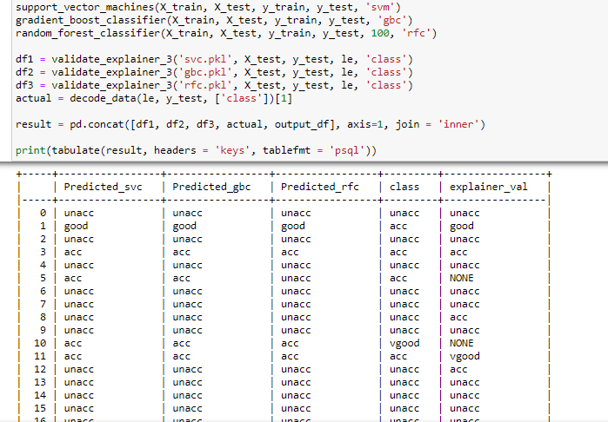
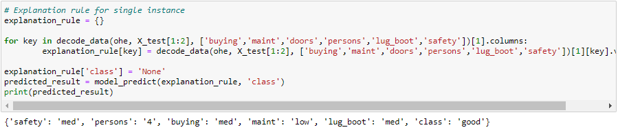
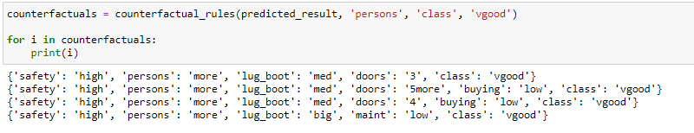
RESULTS
Explanations and counterfactual explanations for single instance
IT18113600 | Perera G.Y.N | 2021-117

Slide 29

IT 18134704 | J.K. Kenneth chamara
Data Science
IT 18134704 | J.K. Kenneth Chamara | 2021-117

Slide 30
Introduction
IT 18134704 | J.K. Kenneth Chamara | 2021-117

Slide 31
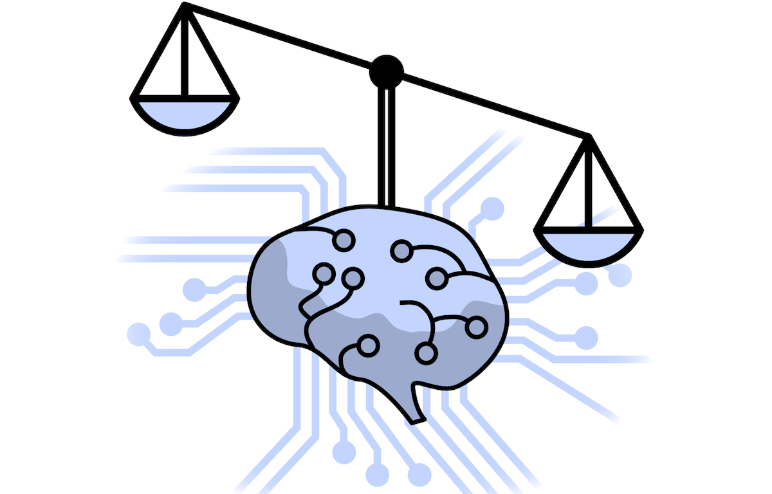
BACKGROUND
What is fairness In ML ?
“...discrimination is considered to be present if for two individuals that have the same characteristic relevant to the decision making and differ only in the sensitive attribute (e.g., gender/race) a model results in different decisions”
ToonCaldersandIndr˙eŽliobait˙e.2013 [1].
IT 18134704 | J.K. Kenneth Chamara | 2021-117

Slide 32
BACKGROUND cont..
Why we need fairness in ML?
Improve reliability
Avoid ethical concerns
lead to more accurate decisions
Why don’t ML models have fairness?
ML algorithms collect unwanted bias in training data.
IT 18134704 | J.K. Kenneth Chamara | 2021-117

Slide 33

RESEARCH PROBLEM
Implementing a Framework to measure the Fairness in an ML model for a given restricted attribute ?
IT 18134704 | J.K. Kenneth Chamara | 2021-117

Slide 34
OBJECTIVES
Specific Objective
Sub Objectives
Developing a model agnostic library to detect fairness in Machine learning models
Develop DNN model for binary classification.
Implementing the methodology to detect fairness by analysing the implemented ML model and data.
Implementing the developed methodology programmatically in a generalized manner.
Implementing permutating features for sample set.
IT 18134704 | J.K. Kenneth Chamara | 2021-117

Slide 35

Research Methodology
IT 18134704 | J.K. Kenneth Chamara | 2021-117

Slide 36
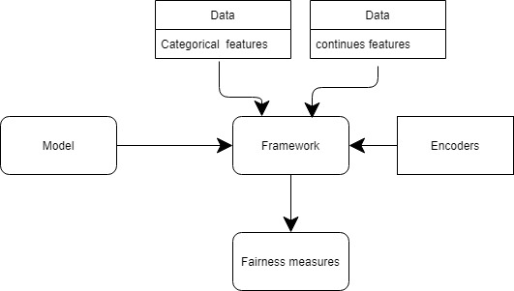
SYSTEM OVERVIEW DIAGRAM
IT 18134704 | J.K. Kenneth Chamara | 2021-117

Slide 37
Derivation Of Fairness Formula
Requirement
Data set (categorical columns , etc..)
Trained ML model
Used encoders
How can we derive a fairness measure from a ML model?
IT 18134704 | J.K. Kenneth Chamara | 2021-117

Slide 38
Derivation Of Fairness Formula cont.
Features
Prediction
age | Salary | Gender | Designation
30 | 60,000 | Male | Teacher
1
Unfair
Model
age | Salary | Gender | Designation
30 | 60,000 | Female | Teacher
0
IT 18134704 | J.K. Kenneth Chamara | 2021-117

Slide 39
Derivation Of Fairness Formula cont.
Features
Prediction
age | Salary | Gender | Designation
30 | 60,000 | Male | Teacher
1
Model
Fair
age | Salary | Gender | Designation
30 | 60,000 | Female | Teacher
1
IT 18134704 | J.K. Kenneth Chamara | 2021-117

Slide 40
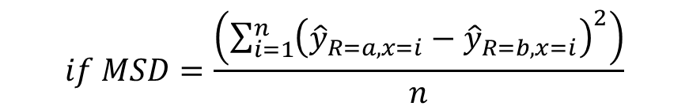
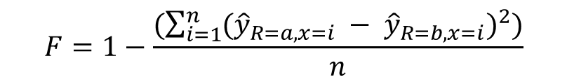

Derivation Of Fairness Formula cont.
X – Features
R – Restricted Attribute
y – Dependent variable
MSD – Mean Squared Difference
n – number of samples
$$F=1−\frac{(\sum_{i=1}^{n}{{({\hat{y}}_{R=a,x=i} − {\hat{y}}_{R=b,x=i})}^{2}})}{n}$$
$$if MSD=\frac{\left(\sum_{i=1}^{n}{{\left({\hat{y}}_{R=a,x=i}−{\hat{y}}_{R=b,x=i}\right)}^{2}}\right)}{n}$$
{X: {0, 1}}
{R: {0,1,2,…,m}}
{y: {0,1}}
R ϵ X
$$F=1−MSD$$
IT 18134704 | J.K. Kenneth Chamara | 2021-117

Slide 41
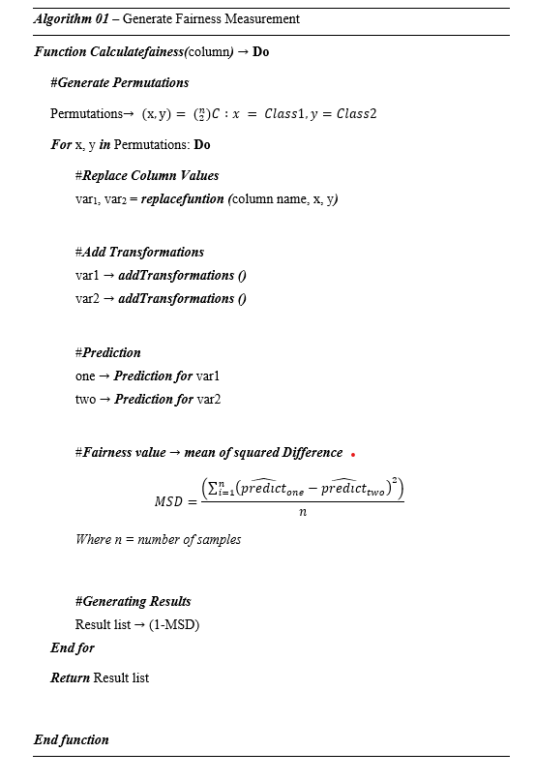
Algorithm
Generate permutations
Replace values
Add transformations
Predictions
Generate MSD
Return Fairness measures
IT 18134704 | J.K. Kenneth Chamara | 2021-117

Slide 42
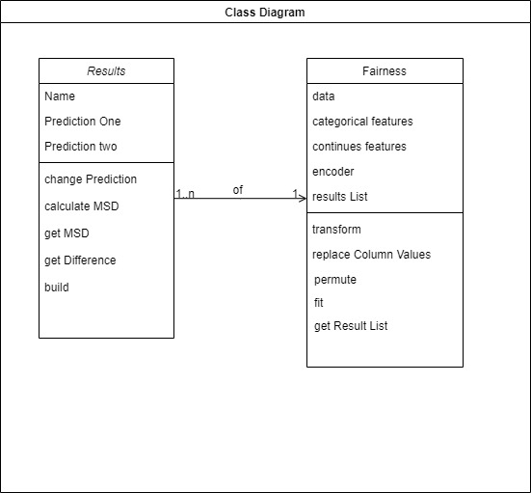
Class Diagram
IT 18134704 | J.K. Kenneth Chamara | 2021-117

Slide 43
Completion
STEP 1
STEP 2
STEP 3
STEP 4
STEP 5
STEP 6
Dataset
Selection and cleansing
ML learning Model implementation
Implementation
of
The Algorithm
Framework implementation
Testing
Framework
with the
ML Model
Testing with Different
Data Sets and
Optimizing
IT 18134704 | J.K. Kenneth Chamara | 2021-117

Slide 44
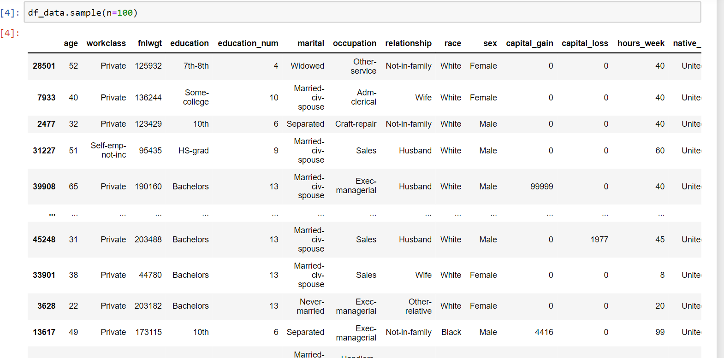
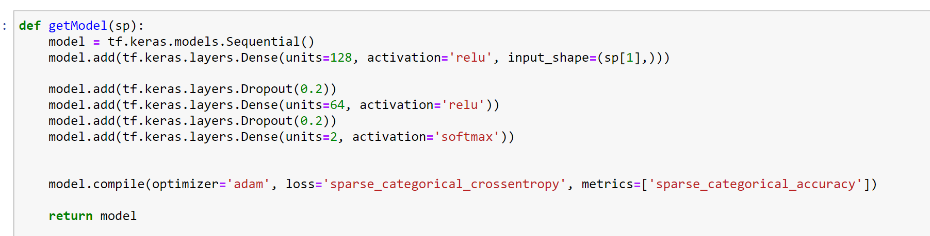
data Set and ML Model
4 Layer Neural Network
With 2 drop out layers
81% Accuracy
IT 18134704 | J.K. Kenneth Chamara | 2021-117

Slide 45
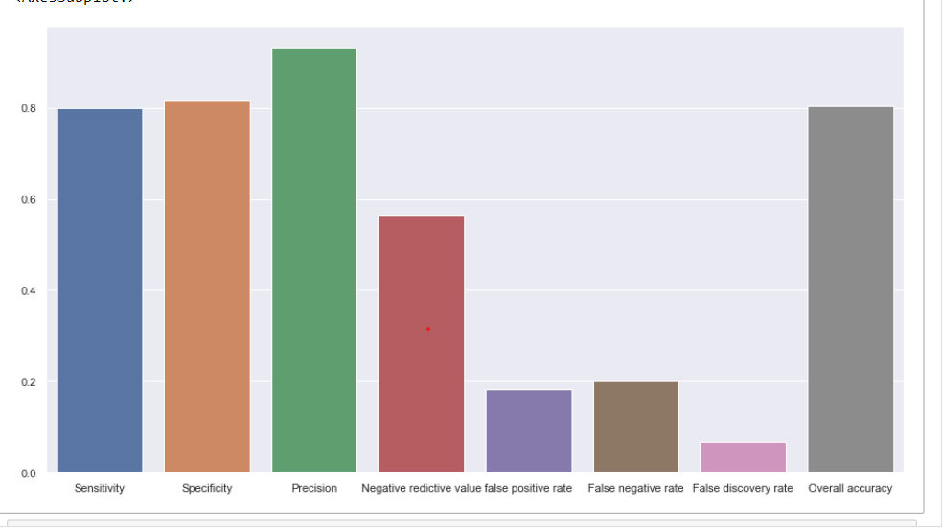
ML Model Evaluation.
Model evaluation:
As shown in the figure sensitivity of the model predictions is around 80%. Which is indicate relatively better predictive accuracy from the model.
True negative rate / specificity of predations is around 82%, which is also a positive indication of the model performance
Precision of the predictions is 94%. Which is significant amount to indicate that fraction of actual positives among examples predicted as positive.
But false negative, false positive are higher than 10% which is not a verry good indication of the model
IT 18134704 | J.K. Kenneth Chamara | 2021-117

Slide 46
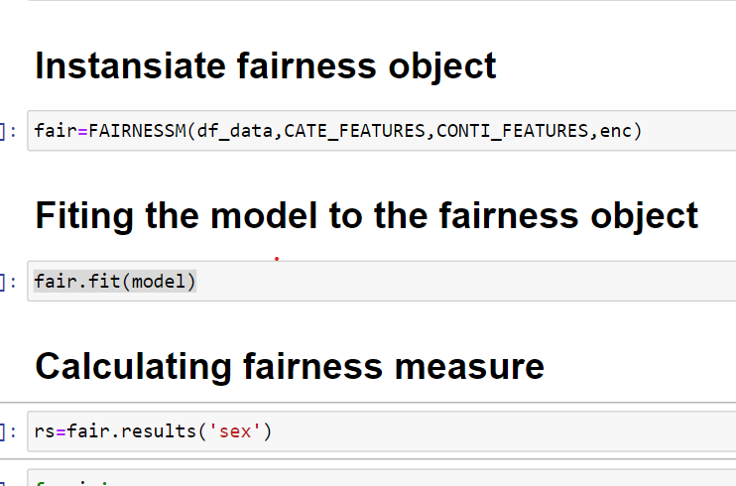
How to Use the Framework
3 Step Process
Create the fairness object with passing the data and column names and the encoder used in the pre-processing step
Fitting the Model
Passing the column name
IT 18134704 | J.K. Kenneth Chamara | 2021-117

Slide 47
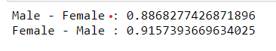
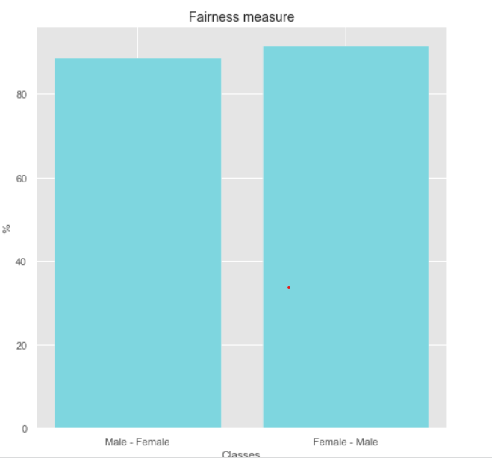
Results
11.32%
Unfairness against male to female by the model
8.43%
Unfairness against female to male by the model
IT 18134704 | J.K. Kenneth Chamara | 2021-117

Slide 48
TECHNOLOGIES, TECHNIQUES & ALGORITHMS
Technologies
Development : Python
Techniques
Probability and Statistics
OOP
Algorithms
Deep neural network algorithm for binary classification
Data Structures and algorithms
Tensorflow
IT 18134704 | J.K. Kenneth Chamara | 2021-117

Slide 49


What’s Next ???
Testing with different datasets
Improvements to Data Handling
IT 18134704 | J.K. Kenneth Chamara | 2021-117

Slide 50

It18059564 | Abeyagunasekera S.h.p
Data Science
IT18059564 | ABEYAGUNASEKERA S.H.P | 2021-117
IT 18059564 | Abeyagunasekara S.H.P | 2021-117

Slide 51
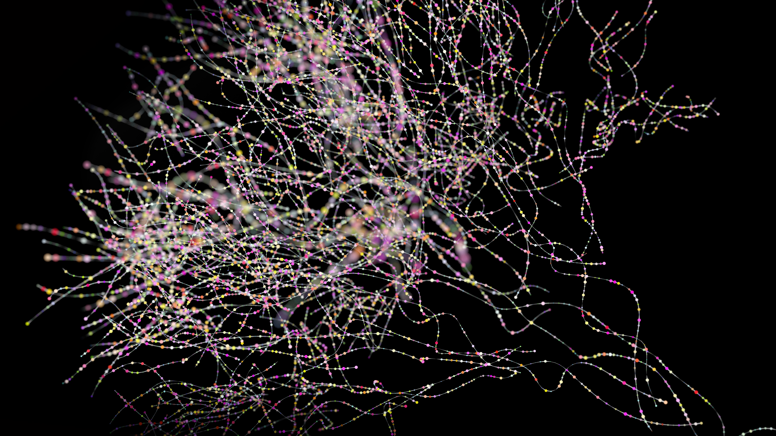
Introduction
IT18059564 | ABEYAGUNASEKERA S.H.P | 2021-117
IT 18059564 | Abeyagunasekara S.H.P | 2021-117

Slide 52
BACKGROUND
Convolutional neural networks are widely use in image classification.
Disease diagnosis using medical images are popular.
Since the CNNs are balck box models the predictions are uninterpritable.
Current image based disease diagnosis systems are unilizing single method of explanations.
Use of multiple explanation methods to explain a prediction given by CNN increase the confidence of the decision.
IT18059564 | ABEYAGUNASEKERA S.H.P | 2021-117
IT 18059564 | Abeyagunasekara S.H.P | 2021-117

Slide 53
BACKGROUND (Current Methods).
Superpixels
Superpixels are interconnected pixels with similar colors.
LIME based method.
LIME is Local Interpretable Model Agnostic Explanations.
Integrated gradients method.
It introduce the counterfactual intuition to the explanations by using baseline value to compare the change of output value with respect to input superpixels values on the decision.
Expected gradients an extension of the integrated gradients method proposed in [29].
As an adaptation to make them approximate SHAP values, expected gradients reformulates the integral as an expectation and combines that expectation with sampling reference values from the background dataset/known data points.
Based on if-then rules, which we call anchors.
Anchors: High-Precision Model-Agnostic Explanations.
SHAP GradientExplainer .
IT18059564 | ABEYAGUNASEKERA S.H.P | 2021-117
IT 18059564 | Abeyagunasekara S.H.P | 2021-117

Slide 54
RESEARCH GAP
Achievements \Research papers | [9] | [10] | [15] (2021) | [16] (2020) | [17] (2021)
GSInquire use to identify critical factors | √ | 𝜲 | 𝜲 | 𝜲 | 𝜲
A comparative analysis of various explanability models including DeepLIFT, DeepSHAP, IG, etc was performed for on a model for detection of choroidal neovascularization (CNV), diabetic macular edema (DME), and drusens from optical coherence tomography (OCT) scans | 𝜲 | √ | 𝜲 | 𝜲 | 𝜲
Visualizations of activation mapping (AM). AM origin (mixing) means the AM of models trained without (with) image mixing technique | 𝜲 | 𝜲 | √ | 𝜲 | 𝜲
Surprisingly, results showed [4] that methods like transfer learning and fine tuning had capabilities of performing exceedingly well on medical image analysis tasks | 𝜲 | 𝜲 | 𝜲 | √ | 𝜲
Use of transfer learning in detecting Covid chest X rays | 𝜲 | 𝜲 | 𝜲 | 𝜲 | √
Use of multiple model agnostic techniques to provide unified explanations to medical images | 𝜲 | 𝜲 | 𝜲 | 𝜲 | 𝜲
IT18059564 | ABEYAGUNASEKERA S.H.P | 2021-117

Slide 55
RESEARCH PROBLEM
Determine how to provide unified approach for explaining decisions provided by CNN on medical images.
Use LIME (the explanations are only valid to the given instance)
Use Anchor (Provide general description to the prediction using if then rules)
Use SHAP Gradient explainer (Provide explanations based on expected gradients and utilize more than one input instance)
IT18059564 | ABEYAGUNASEKERA S.H.P | 2021-117
IT 18059564 | Abeyagunasekara S.H.P | 2021-117

Slide 56
OBJECTIVES
Specific Objective
Provide unified explanations to the predictions provided by CNN using currently available methods.
Sub Objectives
Design API to provide predictions with explanations.
Unified approach of existing model agnostic methods to increase the explainability of the CNN model.
A web-based solution.
IT18059564 | ABEYAGUNASEKERA S.H.P | 2021-117
IT 18059564 | Abeyagunasekara S.H.P | 2021-117

Slide 57

IMPLEMENTATION STATUS
Completed
To be Completed
Dataset selection
Experimentation using CNN Models and finalize the classification model.
Methods creation for explanations.
Create Unified explanations using all explanation method.
Create API using explanation methods.
Deploy the API and ML model.
Create frontend for test
IT 18059564 | Abeyagunasekara S.H.P | 2021-117

Slide 58
Research Methodology
IT18059564 | ABEYAGUNASEKERA S.H.P | 2021-117
IT 18059564 | Abeyagunasekara S.H.P | 2021-117

Slide 59
LISA: Unified Method of Explanation
By combining above mentioned methods we introduce LISA algorithm.
It gets the utilize the output of LIME, Integrated Gradients, SHAP, Anchors
Then it produces the union, intersection and LISA explanation boundary as explanations for the instance.
IT 18059564 | Abeyagunasekara S.H.P | 2021-117

Slide 60
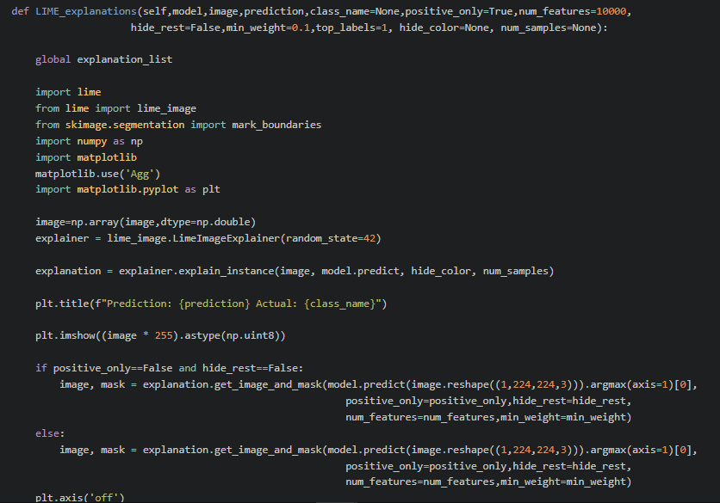
Produces the union, intersection and LISA explanation boundary
LIME Implementation
IT18059564 | ABEYAGUNASEKERA S.H.P | 2021-117
IT 18059564 | Abeyagunasekara S.H.P | 2021-117

Slide 61
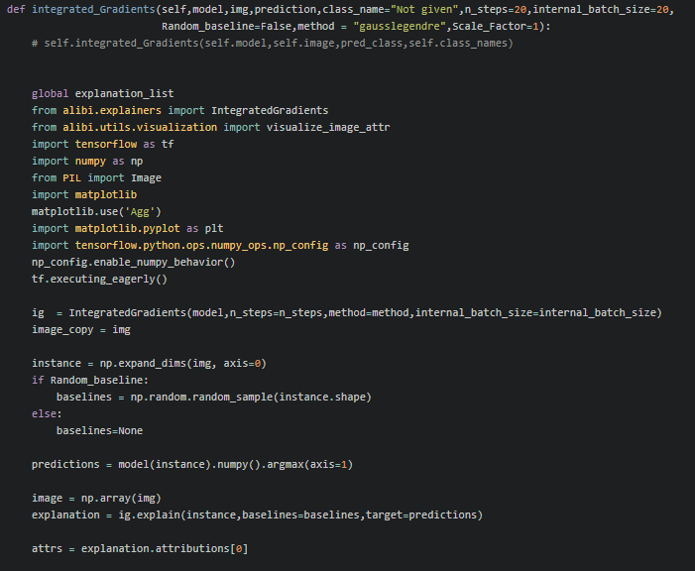
Produces the union, intersection and LISA explanation boundary
Integrated Gradients Implementation
IT18059564 | ABEYAGUNASEKERA S.H.P | 2021-117
IT 18059564 | Abeyagunasekara S.H.P | 2021-117

Slide 62
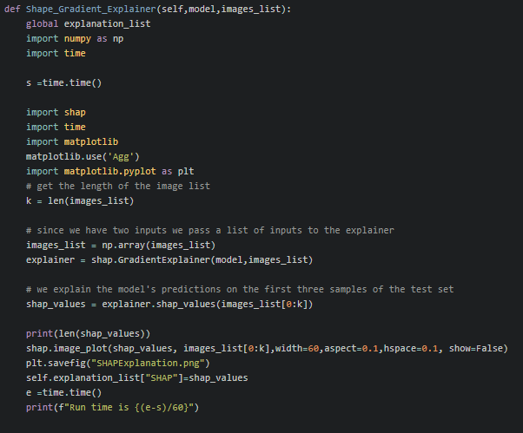
Produces the union, intersection and LISA explanation boundary
SHAP integrated gradients
IT18059564 | ABEYAGUNASEKERA S.H.P | 2021-117
IT 18059564 | Abeyagunasekara S.H.P | 2021-117

Slide 63
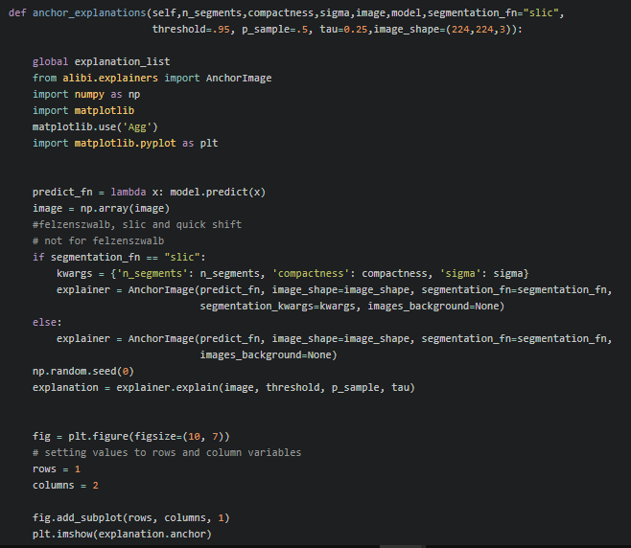
Produces the union, intersection and LISA explanation boundary
Anchor explanation implementation
IT18059564 | ABEYAGUNASEKERA S.H.P | 2021-117
IT 18059564 | Abeyagunasekara S.H.P | 2021-117

Slide 64
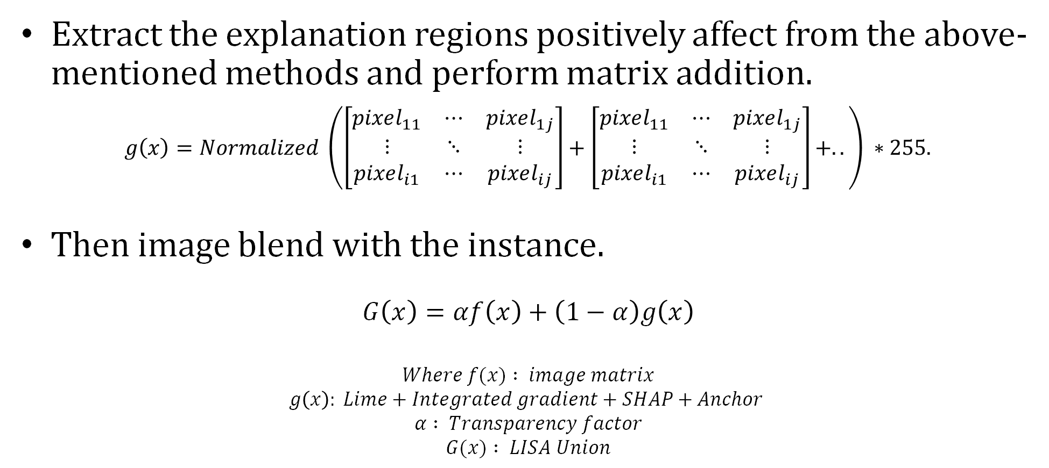
Produces the union of Explanations
Extract the explanation regions positively affect from the above-mentioned methods and perform matrix addition.
$g\left(x\right)=Normalized \left(\left[\begin{matrix}pixel_{11} & ⋯ & pixel_{1j} \\ ⋮ & ⋱ & ⋮ \\ pixel_{i1} & ⋯ & pixel_{ij}\end{matrix}\right]+\left[\begin{matrix}pixel_{11} & ⋯ & pixel_{1j} \\ ⋮ & ⋱ & ⋮ \\ pixel_{i1} & ⋯ & pixel_{ij}\end{matrix}\right]+..\right) ∗255.$
Then image blend with the instance.
$$G\left(x\right)=αf\left(x\right)+\left(1−α\right)g\left(x\right)$$
$$Where f(x) : image matrix$$
$$g\left(x\right): Lime+Integrated gradient+SHAP+Anchor$$
$$α : Transparency factor$$
$$G(x) : LISA Union$$
IT 18059564 | Abeyagunasekara S.H.P | 2021-117

Slide 65
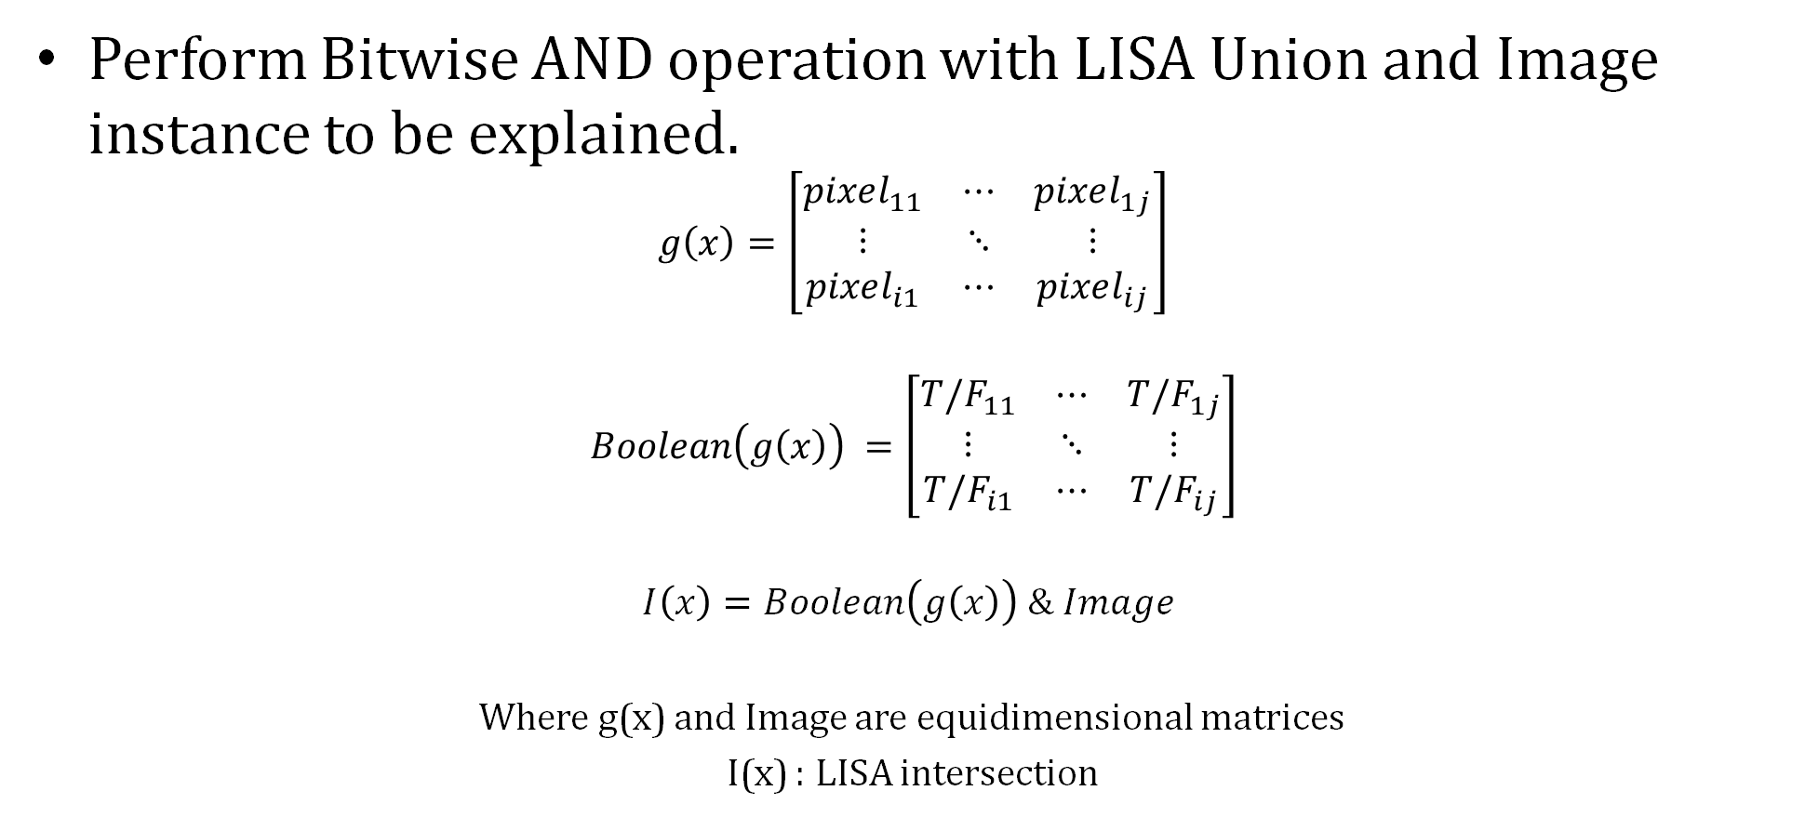
Produces the intersection of Explanations
Perform Bitwise AND operation with LISA Union and Image instance to be explained.
$$g\left(x\right)=\left[\begin{matrix}pixel_{11} & ⋯ & pixel_{1j} \\ ⋮ & ⋱ & ⋮ \\ pixel_{i1} & ⋯ & pixel_{ij}\end{matrix}\right]$$
$$Boolean\left(g\left(x\right)\right) =\left[\begin{matrix}T/F_{11} & ⋯ & T/F_{1j} \\ ⋮ & ⋱ & ⋮ \\ T/F_{i1} & ⋯ & T/F_{ij}\end{matrix}\right]$$
$$I\left(x\right)=Boolean\left(g\left(x\right)\right) \& Image$$
Where g(x) and Image are equidimensional matrices
I(x) : LISA intersection
IT 18059564 | Abeyagunasekara S.H.P | 2021-117

Slide 66
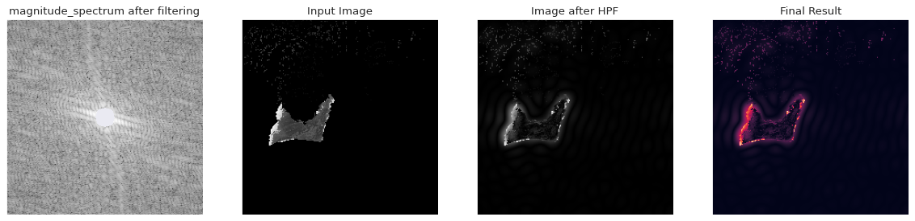
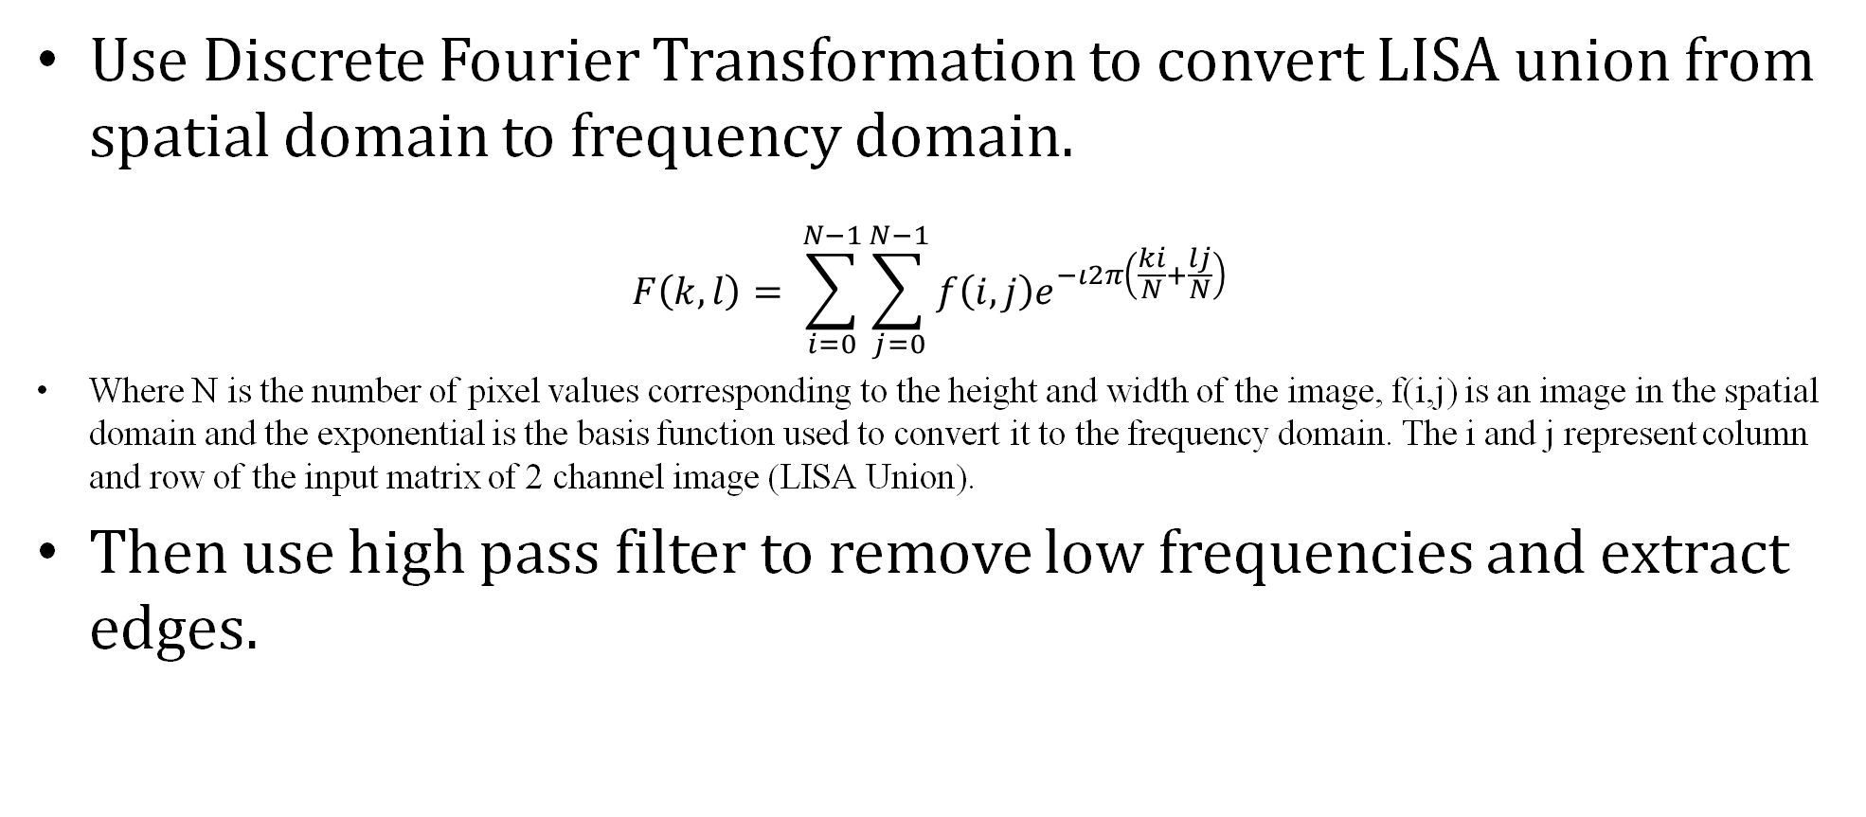
Produces the LISA Explanation boundary
Use Discrete Fourier Transformation to convert LISA union from spatial domain to frequency domain.
$$F\left(k,l\right)= \sum_{i=0}^{N−1}{\sum_{j=0}^{N−1}{f\left(i,j\right)e^{−ι2π\left(\frac{ki}{N}+\frac{lj}{N}\right)}}}$$
Where N is the number of pixel values corresponding to the height and width of the image, f(i,j) is an image in the spatial domain and the exponential is the basis function used to convert it to the frequency domain. The i and j represent column and row of the input matrix of 2 channel image (LISA Union).
Then use high pass filter to remove low frequencies and extract edges.
IT 18059564 | Abeyagunasekara S.H.P | 2021-117

Slide 67
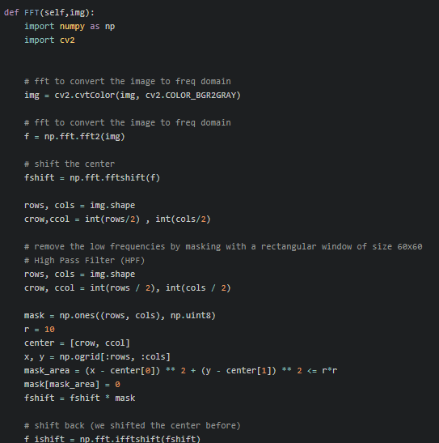
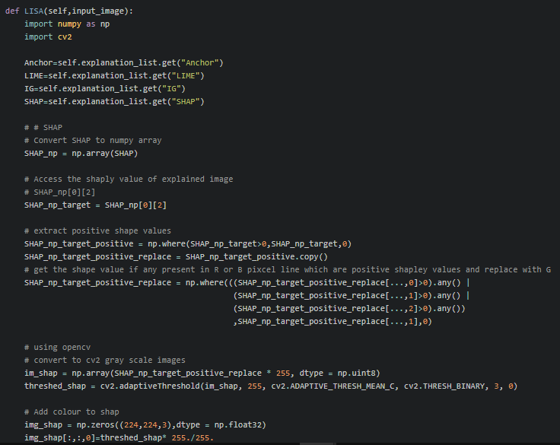
Produces the LISA Explanation boundary
IT18059564 | ABEYAGUNASEKERA S.H.P | 2021-117
IT 18059564 | Abeyagunasekara S.H.P | 2021-117

Slide 68
TECHNOLOGY, TECHNIQUES & ALGORITHMS
Technology
Development:
Techniques
Anchors
LIME
SHAP
Web Technologies
Python
Rest APIs using Flask
Front End:
React.js
Integrated Gradients
IT18059564 | ABEYAGUNASEKERA S.H.P | 2021-117
IT 18059564 | Abeyagunasekara S.H.P | 2021-117

Slide 69
Limitations
Deployment
Runtime
Need high memory server to run the explanation methods.
Time take to generate explanations are high. (avg: 26 min in GPU enabled Colab instance )
Solution
Solution
Deploy the API with backend logic to high memory instance in production stage.
Use multi-threading to improve execution time of the explanation methods.
IT 18059564 | Abeyagunasekara S.H.P | 2021-117

Slide 70

Results and Discussion
Comparative analysis of positive Covid-19 CXR with LISA and previous methods.
Prediction provided
IT 18059564 | Abeyagunasekara S.H.P | 2021-117

Slide 71

Explanations by previous methods
LIME
LIME explanation
IT 18059564 | Abeyagunasekara S.H.P | 2021-117

Slide 72

Explanations by previous methods
Integrated Gradients
Integrated Gradients
IT 18059564 | Abeyagunasekara S.H.P | 2021-117

Slide 73

Explanations by previous methods
SHAP
SHAP explanation
IT 18059564 | Abeyagunasekara S.H.P | 2021-117

Slide 74

Explanations by previous methods
Anchor
Anchor explanation
Anchor Failed to provide explanation
IT 18059564 | Abeyagunasekara S.H.P | 2021-117

Slide 75



Newly proposed method
LISA
LISA explanation
LISA Union
LISA Decision Boundary
LISA Intersection
IT 18059564 | Abeyagunasekara S.H.P | 2021-117

Slide 76


Implementation Status of API
Use Python microframework flask to implement APIs
End point for providing explanations to Covid-19 CXRs
End point for providing explanations to CNN models for model evaluation
IT 18059564 | Abeyagunasekara S.H.P | 2021-117

Slide 77

Implementation Status of API
IT 18059564 | Abeyagunasekara S.H.P | 2021-117

Slide 78

Implementation Status of API
Test result of API with Postman
IT 18059564 | Abeyagunasekara S.H.P | 2021-117

Slide 79
Usability
Can be used as prediction platform with explainability to detect covid-19 CXRs
Can be used as model evaluation platform to detect whether the CNN model predictions are relying with domain knowledge of human in a given field
IT 18059564 | Abeyagunasekara S.H.P | 2021-117

Slide 80

Contribution to literature
We were able to compile a paper about the proposed method.
“LISA : Enhance the explainability of medical images unifying current XAI techniques ”
The above titled paper accepted to present in IEEE 2022 7th International Conference for Convergence in Technology (I2CT),Pune, Maharashtra, India.
IT 18059564 | Abeyagunasekara S.H.P | 2021-117

Slide 81
Completion
STEP 1
STEP 2
STEP 3
STEP 4
Data Set Selection
Model Creation
Explanation methods implementation
API Creation
IT 18056976 | G.L. Udari Kaushalya | 2021-117

Slide 82

IT 18056976 | G.L. Udari Kaushalya
Data Science
IT 18056976 | G.L. Udari Kaushalya | 2021-117

Slide 83
Introduction
IT 18056976 | G.L. Udari Kaushalya | 2021-117

Slide 84
BACKGROUND Cont.
Is K-NN Whitebox ?
Non-Parametric No Interpretability on a
Modular Level
Interpretability Interpretability of Single
depends on Instances of Data Set
If an Instance Consists of Hundreds of Features [19] ? ? ? ? ? ?
IT 18056976 | G.L. Udari Kaushalya | 2021-117

Slide 85
BACKGROUND Cont.
What is CURSE OF DIMENSIONALITY ?
No of dimensions increases , the volume of the input space increases at an exponential rate.
In such instances, points that appear to be similar may be separated by a large distance.
All points will be far away from each other
IT 18056976 | G.L. Udari Kaushalya | 2021-117

Slide 86
BACKGROUND Cont.
This might feel unintuitive at first
Since this becomes BLACK-BOX when it has more dimensions
Dimension Reduction is applicable
Extracting Explanation is needed
There are several ways of Attribute Reduction for Interpretable k-NN model…
New Approach
IT 18056976 | G.L. Udari Kaushalya | 2021-117

Slide 87

RESEARCH PROBLEM
How to get an Explanation for k-Nearest Neighbors model outcome, overcoming the ‘Curse of Dimensionality’ ?
IT 18056976 | G.L. Udari Kaushalya | 2021-117

Slide 88
OBJECTIVES
Specific Objective
To Enhance the model interpretability of k-NN model overcoming ‘Curse of Dimensionality’ problem
Sub Objectives
Identify Feature Importance of different features using SHAP values
Dimension Reducing according to feature importance of the SHAP values
Identify most effective attributes for the Classification
Create a dissimilarity measure using SHAP values to identify nearest neighbors
Extract Explanations for Classification
IT 18056976 | G.L. Udari Kaushalya | 2021-117
IT 18056976 | G.L. Udari Kaushalya | 2021-117

Slide 89

K-Important Neighbors
Approach of Binary Classification with High Dimension Data
Existing Methodologies – Mainly K-IN:
Implemented Smoothly Clipped Absolute Deviation (SCAD) Penalty Regression to Identify a Feature Value
Generate a Dissimilarity Measure to identify nearest neighbors
But Drawbacks ?????
IT 18056976 | G.L. Udari Kaushalya | 2021-117

Slide 90
This Approach….
Approach of Binary Classification with High Dimension Data
Why not SCAD ?
Why not SHAP or LIME?
Why SHAP?
Technologies :
Implemented a feature value based on Explanation Techniques
Generate a Dissimilarity Measure to identify nearest neighbors
Extract Explanations
IT 18056976 | G.L. Udari Kaushalya | 2021-117

Slide 91
Research Methodology
IT 18056976 | G.L. Udari Kaushalya | 2021-117

Slide 92

SYSTEM OVERVIEW DIAGRAM
IT 18056976 | G.L. Udari Kaushalya | 2021-117

Slide 93
Completion
STEP 1
STEP 2
STEP 3
STEP 4
STEP 5
STEP 6
Datasets Selection
& Identify the Dimension Reduction Methodology
Creating the Dissimilarity measure and
apply for small Datasets
Reducing Dimensions
applying for
Large Data Sets using SHAP
Values
Define the
Explanations
Output and
Apply function
For Get
Explanations
Test the methodology
for Different
Data Sets
with High
Dimensions
Implement the Library using created functions and optimizing
IT 18056976 | G.L. Udari Kaushalya | 2021-117

Slide 94




Step 1 : SHAP BASED K-NN Algorithm
IT 18056976 | G.L. Udari Kaushalya | 2021-117

Slide 95


Step 1 : Identify feature extraction method
WHY LIME or SHAP ???
Explanation Models
Feature Value Extraction
LIME
SHAP
IT 18056976 | G.L. Udari Kaushalya | 2021-117

Slide 96


Step 1 : Selecting datasets
Limitations :
Binary Classification Data
0
Types :
Dataset with few dimensions for creating the Dissimilarity Measure
Iris Dataset 4 Features
High Dimensional Datasets for Classification
Breast Cancer Data 30 Features
Ionosphere Data 34 Features
Connectionist Bench Data 60 Features
Ozone Data 73 Features
LSTV Voice Rehabilitation Data 309 Features
Madelon Data 500 Features
IT 18056976 | G.L. Udari Kaushalya | 2021-117

Slide 97


SHAP – SHapley Additive Explanations
Calculate the contribution of each feature to the prediction of a specific instance
Used in – Need of understanding what decisions the model is making
IT 18056976 | G.L. Udari Kaushalya | 2021-117

Slide 98



Step 2 : creating dissimilarity measure
Get the feature importance value using absolute SHAP value and create a measure
Absolute Mean ? Or Absolute Max or Min?
IT 18056976 | G.L. Udari Kaushalya | 2021-117

Slide 99


Step 2 : creating dissimilarity measure
Impose the contribution of Feature value into Euclidian Distance
IT 18056976 | G.L. Udari Kaushalya | 2021-117

Slide 100


Step 2 : creating dissimilarity measure
Implementation of Dissimilarity Measure and test for two data points
IT 18056976 | G.L. Udari Kaushalya | 2021-117

Slide 101



Step 2 : creating dissimilarity measure and classification
Get Sorted Distance List
Then Classification
IT 18056976 | G.L. Udari Kaushalya | 2021-117

Slide 102

Step 3 : Accuracy testing
Compare the Accuracy with Basic K-NN Algorithm
IT 18056976 | G.L. Udari Kaushalya | 2021-117

Slide 103


Step 3 : Best k value defining
Best K-Value is Obtained
via a Graph
IT 18056976 | G.L. Udari Kaushalya | 2021-117

Slide 104


Step 4 : extract explanations
Extracted Explanation
IT 18056976 | G.L. Udari Kaushalya | 2021-117

Slide 105
Step 5 : APPLY & TESTING
Data Set |  |  | Model Accuracy
Name | k value | Attributes | SHAP based K-NN | K-NN | SVM
Breast Cancer | 4 | 30 | 0.96 | 0.95 | 0.96
Ionosphere | 9 | 34 | 0.90 | 0.85 | 0.90
Connectionist Bench | 4 | 60 | 0.87 | 0.75 | 0.82
Ozone | 9 | 73 | 0.94 | 0.93 | 0.94
LSTV Voice | 5 | 309 | 0.84 | 0.78 | 0.75
Madelon | 12 | 500 | 0.82 | 0.66 | 0.60
IT 18056976 | G.L. Udari Kaushalya | 2021-117

Slide 106
What’s Next ???
Implement the Library for SHAP based
K-NN Algorithm using created functions
Optimize the Mechanisms Used in Implementation
IT 18056976 | G.L. Udari Kaushalya | 2021-117

Slide 107
TECHNOLOGIES, TECHNIQUES & ALGORITHMS
Technologies
Development : Python
Techniques
Dimension Reduction
Algorithms
K-Nearest Neighbour basic and improved algorithms
Shapley Additive Explanations
IT 18056976 | G.L. Udari Kaushalya | 2021-117

Slide 108
Supportive Information
Commercialization
Budget (if any)
2021-117

Slide 109




SYSTEM, PERSONNEL & SOFTWARE SPECIFICATION REQUIREMENTS
Software Specification Requirements
PyCharm
Jupiter Notebook
Visual Studio Code
GitLab
2021-117

Slide 110
NON-FUNCTIONAL REQUIREMENTS
Basic Understanding of how to use machine learning models in python
Keras APIs / Sklearn should be understandable
Response Time
Extra features can be added without damaging the main functions
2021-117

Slide 111
REFERENCES
[1] ToonCaldersandIndr˙eŽliobait˙e.2013. Why Unbiased Computational Processes CanLeadtoDiscriminativeDecisionProcedures.SpringerBerlinHeidelberg,Berlin, Heidelberg,43–57. https://doi.org/10.1007/978-3-642-30487-3_3
[2] R. Zemel, Y. Wu, K. Swersky, T. Pitassi and C. Dwork, "Learning fair representations", International Conference on Machine Learning, pp. 325-333, 2013.
[3] M. Hardt, E. Price and N. Srebro, "Equality of Opportunity in Supervised Learning", Advances in Neural Information Processing Systems, pp. 3315-3323, 2016.
[4] F. Kamiran, A. Karim and X. Zhang, "Decision theory for discrimination-aware classification", IEEE 12th International Conference on Data Mining, pp. 924-929, 2012.
[5] M. Joseph, M. Kearns, J. Morgenstern, S. Neel and A. Roth, "Rawlsian Fairness for Machine Learning", arXiv Prepr. arXiv1610.09559, vol. 1, no. 2, pp. 1-26, 2016.
[6] A. Stevens, P. Deruyck, Z. V. Veldhoven and J. Vanthienen, "Explainability and Fairness in Machine Learning: Improve Fair End-to-end Lending for Kiva," 2020 IEEE Symposium Series on Computational Intelligence (SSCI), Canberra, ACT, Australia, 2020, pp. 1241-1248, doi: 10.1109/SSCI47803.2020.9308371.
[7] Leo Breiman "Random Forest" 2001
[8] Tianqui Chen, Carlos Guestrin. "XGBoost: A Scalable Tree Boosting System". 2016
[9] Linda Wang, Zhong Qiu Lin, and Alexander Wong. "COVID-Net: A Tailored Deep Convolutional Neural Network Design for Detection of COVID-19 Cases from Chest X-Ray Images" (2020)
[10] Amitojdeep Singh, Sourya Sengupta,and Vasudevan Lakshminarayanan "Explainable deep learning models in medical image analysis" (2020)
[11] Molnar, Christoph. "Interpretable machine learning. A Guide for Making Black Box Models Explainable", 2019. https://christophm.github.io/interpretable-ml-book/.
2021-117

Slide 112
REFERENCES Cont.
[12]A. Adadi and M. Berrada, "Peeking Inside the Black-Box: A Survey on Explainable Artificial Intelligence (XAI)," in IEEE Access, vol. 6, pp. 52138-52160, 2018, doi: 10.1109/ACCESS.2018.2870052.
[13] Mothilal, Ramaravind K., Amit Sharma, and Chenhao Tan. "Explaining machine learning classifiers through diverse counterfactual explanations." Proceedings of the 2020 Conference on Fairness, Accountability, and Transparency. 2020
[14]Ribeiro, Marco Tulio, Sameer Singh, and Carlos Guestrin. "Why should I trust you?: Explaining the predictions of any classifier." Proceedings of the 22nd ACM SIGKDD international conference on knowledge discovery and data mining. ACM (2016)
[15] Yu-Huan Wu, Shang-Hua Gao, Jie Mei, Jun Xu, Deng-Ping Fan, Rong-Guo Zhang, Ming-Ming Cheng "JCS: An Explainable COVID-19 Diagnosis System by Joint Classification and Segmentation (2021)
[16] Aritra Chowdhury, Alberto Santamaria-Pang, James R. Kubricht, Peter Tu “Emergent symbolic language based deep medical image classification
” (2020)
[17] Narayana Darapaneni; Tushar Gupta; Anwesh Reddy Paduri; Arpit Banerji; Sanjay Sharma; Dishant Sharma; Nitin Gupta "Inception C-Net(IC-Net): Altered Inception Module for Detection of Covid-19 and Pneumonia using Chest X-rays". (2021)
[18] F. Shakerin and G. Gupta, “White-box Induction from SVM Models: Explainable AI with Logic Programming,” Theory Pract. Log. Program., vol. 20, no. 5, pp. 656–670, 2020, doi: 10.1017/S1471068420000356.
[19] R. Guidotti, A. Monreale, S. Ruggieri, D. Pedreschi, F. Turini, and F. Giannotti, “Local rule-based explanations of black box decision systems,” arXiv, no. May, 2018.
[20] R. Guidotti, A. Monreale, F. Giannotti, D. Pedreschi, S. Ruggieri, and F. Turini, “Factual and Counterfactual Explanations for Black Box Decision Making,” IEEE Intell. Syst., vol. 34, no. 6, pp. 14–23, 2019, doi: 10.1109/MIS.2019.2957223.
[21] M. T. Ribeiro and C. Guestrin, “Anchors : High-Precision Model-Agnostic Explanations,” pp. 1527–1535.
2021-117

Slide 113
REFERENCES Cont.
[22]Molnar, Christoph. "Interpretable machine learning. A Guide for Making Black Box Models Explainable", 2019. https://christophm.github.io/interpretable-ml-book/.
[23] W. Xueli, J. Zhiyong and Y. Dahai, "An Improved KNN Algorithm Based on Kernel Methods and Attribute Reduction," 2015 Fifth International Conference on Instrumentation and Measurement, Computer, Communication and Control (IMCCC), Qinhuangdao, China, 2015, pp. 567-570, doi: 10.1109/IMCCC.2015.125.
[24] Maierhofer, Thomas (2017). Classification of Functional Data. Interpretable Ensemble Approaches. Master Thesis, Faculty of Mathematics, Computer Science and Statistics, Ludwig-Maximilians-Universität München.
[25] Kouiroukidis, N., & Evangelidis, G. (2011). The Effects of Dimensionality Curse in High Dimensional kNN Search. 2011 15th Panhellenic Conference on Informatics, 41-45.
[26] Schuh, M.A., Wylie, T., & Angryk, R. (2014). Mitigating the Curse of Dimensionality for Exact kNN Retrieval. FLAIRS Conference.
[27] Shahraki, H.R., Pourahmad, S., & Zare, N. (2017). K Important Neighbors: A Novel Approach to Binary Classification in High Dimensional Data. BioMed Research International, 2017.
[28]Nazneen Fatema Rajani, Ben Krause, Wengpeng Yin, Tong Niu, Richard Socher & Caiming Xiong. (2020). Explaining and Improving Model Behavior with k Nearest Neighbor Representations.
[29] Scott Lundberg and Su-In Lee. “A unified approach to interpreting model predictions.” In: CoRR abs/1705.07874.6 (2017). arXiv: 1705. 07874. URL: http://arxiv.org/abs/1705.07874.
2021-117

Slide 114
THANK YOU!

